Slide 1
Managed Scenario

Slide 2
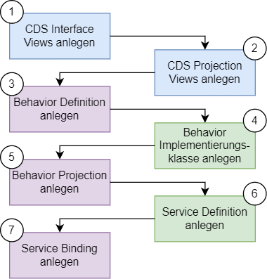
RAP Implementierungs-Workflow
Create CDS Views
Create CDS Projection Views
Create Behavior Definition
Create Behavior Class
Create Behavior Projection
Create Service Defintion
Create Service Bindung

Slide 3



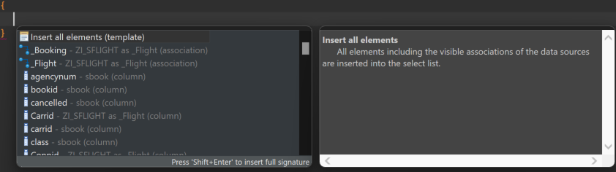

Create CDS Views
Define root entity and child entities
Specify data source
Insert elements of the entities
Define relationships between root and child entities.
Annotate semantic properties of the elements

Slide 4
@AbapCatalog.viewEnhancementCategory: [#NONE]
@AccessControl.authorizationCheck: #NOT_REQUIRED
@EndUserText.label: 'Interface View SBook'
@Metadata.ignorePropagatedAnnotations: true
@ObjectModel.usageType:{
serviceQuality: #X,
sizeCategory: #S,
dataClass: #MIXED
}
define view entity ZI_SBOOK
as select from sbook
association to parent ZI_SFLIGHT as _Flight on $projection.Carrid = _Flight.Carrid
and $projection.Connid = _Flight.Connid
and $projection.Fldate = _Flight.Fldate
{
key carrid as Carrid,
key connid as Connid,
key fldate as Fldate,
key bookid as Bookid,
customid as Customid,
custtype as Custtype,
smoker as Smoker,
@Semantics.quantity.unitOfMeasure: 'Wunit'
luggweight as Luggweight,
wunit as Wunit,
invoice as Invoice,
class as Class,
@Semantics.amount.currencyCode: 'Forcurkey'
forcuram as Forcuram,
forcurkey as Forcurkey,
@Semantics.amount.currencyCode: 'Loccurkey'
loccuram as Loccuram,
loccurkey as Loccurkey,
order_date as OrderDate,
counter as Counter,
agencynum as Agencynum,
cancelled as Cancelled,
reserved as Reserved,
passname as Passname,
passform as Passform,
passbirth as Passbirth,
_Flight
}
ZI_SFLIGHT
ZI_SBOOK
@AccessControl.authorizationCheck: #NOT_REQUIRED
@EndUserText.label: 'Interface View SFlight'
define root view entity ZI_SFLIGHT
as select from znm_sflight
composition [0..*] of ZI_SBOOK as _Booking
{
key znm_sflight.carrid as Carrid,
key znm_sflight.connid as Connid,
key znm_sflight.fldate as Fldate,
znm_sflight.price as Price,
znm_sflight.currency as Currency,
znm_sflight.planetype as Planetype,
znm_sflight.seatsmax as Seatsmax,
znm_sflight.seatsocc as Seatsocc,
znm_sflight.paymentsum as Paymentsum,
znm_sflight.seatsmax_b as SeatsmaxB,
znm_sflight.seatsocc_b as SeatsoccB,
znm_sflight.seatsmax_f as SeatsmaxF,
znm_sflight.seatsocc_f as SeatsoccF,
znm_sflight.created_at as CreatedAt,
znm_sflight.created_by as CreatedBy,
znm_sflight.last_changed_at as LastChangedAt,
znm_sflight.last_changed_by as LastChangedBy,
znm_sflight.locl_last_changed_at as LocalLastChangedAt,
_Booking
}

Slide 5



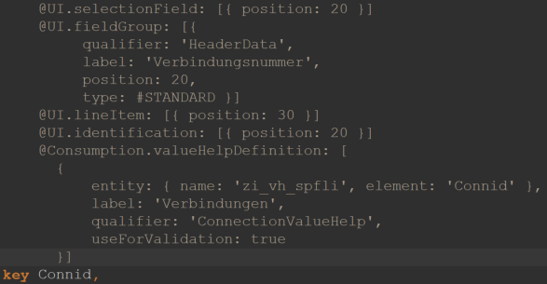
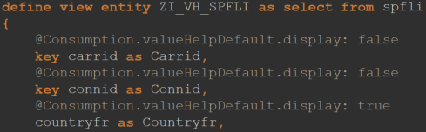
Create projection views
Add UI annotation
lineItem: Display of the element in the list
selectionField: Create a selection field for the element.
Identification: Marking of the element for reference on Object Page.
fieldGroup: Assignment of the element to an element group on the object page.
Create Value Help CDS View and reference in valueHelpDefinition annotation.
Create CDS Projection Views

Slide 6
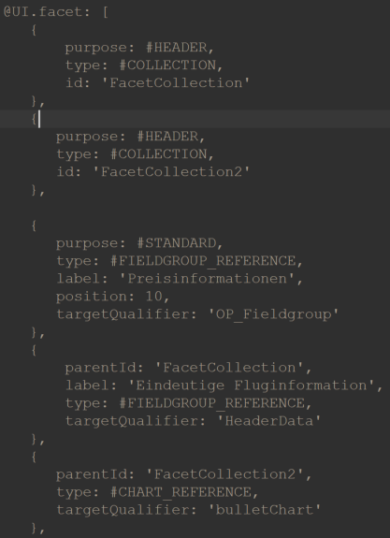
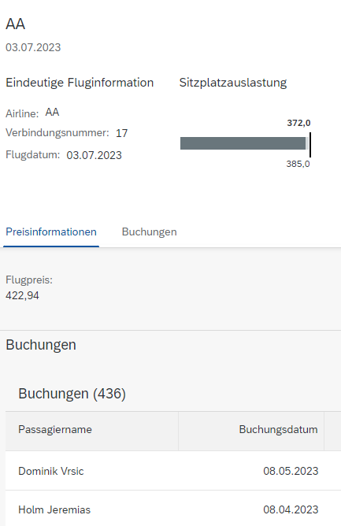
Facets for the object page are defined at the beginning of the definition
purpose: Defines assignment of the facet to the header or standard area
type: defines the type of facet
Different types of bevelling require different handling
Relationships must be included as an element in the element list.
Create CDS Projection Views

Slide 7
ZC_SFLIGHT
@Consumption.valueHelpDefinition: [
{
entity: { name: 'zi_vh_scarr', element: 'Carrid' },
label: 'Fluggesellschaften',
qualifier: 'CarrierValueHelp',
useForValidation: true
}]
@UI: {
lineItem: [
{
position: 10,
importance: #HIGH
}
],
selectionField: [{ position: 10 }],
fieldGroup: [
{
qualifier: 'HeaderData',
position: 10,
label: 'Airline'
}
],
multiLineText: true
}
@UI.identification: [{ position: 10 }]
key Carrid,
@UI.selectionField: [{ position: 20 }]
@UI.fieldGroup: [{
qualifier: 'HeaderData',
label: 'Verbindungsnummer',
position: 20,
type: #STANDARD }]
@UI.lineItem: [{ position: 30 }]
@UI.identification: [{ position: 20 }]
@Consumption.valueHelpDefinition: [
{
entity: { name: 'zi_vh_spfli', element: 'Connid' },
label: 'Verbindungen',
qualifier: 'ConnectionValueHelp',
useForValidation: true
}]
key Connid,
@UI.facet: [
{
purpose: #HEADER,
type: #COLLECTION,
id: 'FacetCollection'
},
{
purpose: #HEADER,
type: #COLLECTION,
id: 'FacetCollection2'
},
{
purpose: #STANDARD,
type: #FIELDGROUP_REFERENCE,
label: 'Preisinformationen',
position: 10,
targetQualifier: 'OP_Fieldgroup'
},
{
parentId: 'FacetCollection',
label: 'Eindeutige Fluginformation',
type: #FIELDGROUP_REFERENCE,
targetQualifier: 'HeaderData'
},
{
parentId: 'FacetCollection2',
type: #CHART_REFERENCE,
targetQualifier: 'bulletChart'
},
{
purpose: #STANDARD,
type: #LINEITEM_REFERENCE,
label: 'Buchungen',
position: 20,
targetElement: '_Booking'
}
]
@EndUserText.label: 'Projection View SFLIGHT'
@AccessControl.authorizationCheck: #NOT_REQUIRED
@UI.headerInfo: {
typeName: 'Flug Root',
typeNamePlural: 'Flüge Root',
title: {
value: 'Carrid',
type: #STANDARD,
label: 'Test'
},
description: {
label: 'Flug Root',
type: #STANDARD,
value: 'Fldate'
}
}
@UI.chart: [
{
qualifier: 'bulletChart',
title: 'Sitzplatzauslastung',
chartType: #BULLET,
measures: [ 'Seatsocc' ],
measureAttributes: [{
measure: 'Seatsocc',
role: #AXIS_1,
asDataPoint: true
}]
}
]
define root view entity ZC_SFLIGHT
provider contract transactional_query
as projection on ZI_SFLIGHT
{

Slide 8
ZC_SFLIGHT
@UI.selectionField: [{ position: 30 }]
@UI.lineItem: [{ position: 40 }]
@UI.fieldGroup: [{
qualifier: 'HeaderData',
label: 'Flugdatum',
position: 30,
type: #STANDARD }]
@UI.identification: [{ position: 30 }]
key Fldate,
@UI.fieldGroup: [{
qualifier: 'OP_Fieldgroup',
position: 10
}]
@UI.identification: [{ position: 40 }]
Price,
Currency,
@UI.lineItem: [{ position: 80 }]
@UI.identification: [{ position: 50 }]
Planetype,
Seatsmax,
@UI: {
dataPoint: {
qualifier: 'Seatsocc',
targetValueElement: 'Seatsmax',
visualization: #PROGRESS,
title: 'Auslastung'
},
lineItem: [
{
type: #AS_DATAPOINT,
label: 'Sitzplatzauslastung Economy',
importance: #HIGH,
position: 50,
valueQualifier: 'Seatsocc'
}
]
}
Seatsocc,
@UI.lineItem: [{ position: 100 }]
Paymentsum,
@Consumption.filter.hidden: true
SeatsmaxB,
@Consumption.filter.hidden: true
@UI.lineItem: [{ position: 100 }]
SeatsoccB,
@Consumption.filter.hidden: true
SeatsmaxF,
@Consumption.filter.hidden: true
@UI.lineItem: [{ position: 100 }]
SeatsoccF,
CreatedAt,
CreatedBy,
LastChangedAt,
LastChangedBy,
LocalLastChangedAt,
/* Associations */
_Booking : redirected to composition child ZC_SBOOK
}

Slide 9
ZC_SBOOK
key Carrid,
key Connid,
key Fldate,
@UI.lineItem: [{ position: 50 }]
@UI.identification: [{ position: 10 }]
key Bookid,
@UI.identification: [{ position: 20 }]
Customid,
@UI.identification: [{ position: 30 }]
Custtype,
@UI.identification: [{ position: 40 }]
Smoker,
@UI.lineItem: [{ position: 30 }]
@UI.identification: [{ position: 50,
type: #FOR_ACTION,
dataAction: 'upgrade_class',
label: 'Upgrade' }]
Luggweight,
Wunit,
Invoice,
@UI.lineItem: [{ position: 40 }]
@UI.identification: [{ position: 51 }]
Class,
Forcuram,
Forcurkey,
Loccuram,
Loccurkey,
@UI.lineItem: [{ position: 20 }]
@UI.identification: [{ position: 60 }]
OrderDate,
Counter,
Agencynum,
Cancelled,
@UI.identification: [{ position: 70 }]
Reserved,
@UI.lineItem: [{ position: 10 }]
Passname,
Passform,
Passbirth,
/* Associations */
_Flight: redirected to parent ZC_SFLIGHT
}
@EndUserText.label: 'Projection View SBOOK'
@AccessControl.authorizationCheck: #NOT_REQUIRED
@UI.headerInfo: {
typeName: 'Buchung',
typeNamePlural: 'Buchungen',
title: {
value: 'Passname',
type: #STANDARD,
label: 'Name'
},
description: {
label: 'Buchungsnummer',
type: #STANDARD,
value: 'Bookid'
}
}
define view entity ZC_SBOOK
as projection on ZI_SBOOK
{
@UI.facet: [{ purpose: #STANDARD,
position: 10,
label: 'Buchungsinformationen',
type: #IDENTIFICATION_REFERENCE }]

Slide 10
ZI_VH_SCARR
ZI_VH_SPFLI
@AbapCatalog.viewEnhancementCategory: [#NONE]
@AccessControl.authorizationCheck: #NOT_REQUIRED
@EndUserText.label: 'Value Help Carrier'
@Metadata.ignorePropagatedAnnotations: true
@ObjectModel.usageType:{
serviceQuality: #X,
sizeCategory: #S,
dataClass: #MIXED
}
define view entity ZI_VH_SCARR as select from scarr
{
@Consumption.valueHelpDefault.display: false
key carrid as Carrid,
@Consumption.valueHelpDefault.display: true
carrname as Carrname,
@Consumption.valueHelpDefault.display: true
currcode as Currcode,
@Consumption.valueHelpDefault.display: true
url as Url
}
@AbapCatalog.viewEnhancementCategory: [#NONE]
@AccessControl.authorizationCheck: #NOT_REQUIRED
@EndUserText.label: 'Value Help Connection'
@Metadata.ignorePropagatedAnnotations: true
@ObjectModel.usageType:{
serviceQuality: #X,
sizeCategory: #S,
dataClass: #MIXED
}
define view entity ZI_VH_SPFLI as select from spfli
{
@Consumption.valueHelpDefault.display: false
key carrid as Carrid,
@Consumption.valueHelpDefault.display: false
key connid as Connid,
@Consumption.valueHelpDefault.display: true
countryfr as Countryfr,
@Consumption.valueHelpDefault.display: true
cityfrom as Cityfrom,
@Consumption.valueHelpDefault.display: true
countryto as Countryto,
@Consumption.valueHelpDefault.display: true
cityto as Cityto
}

Slide 11


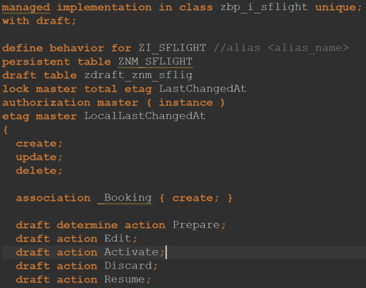
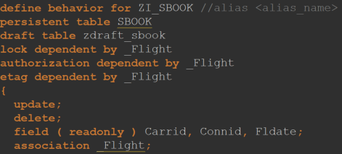
Create Behavior Definition
Create Behavior Class
Behaviour definition for root entity and child Create entities in a development object
Specify name for implementation class and have it created automatically via help
Names for the persistent and draft tables can be specified and created automatically with the help function
Define blocking and authorisation behaviour
Specify CRUD operations that should be possible for the business objects
When using Draft, the Prepare, Edit, Activate, Discard and Resume actions are mandatory

Slide 12
ZI_SFLIGHT
managed implementation in class zbp_i_sflight unique;
with draft;
define behavior for ZI_SFLIGHT //alias <alias_name>
persistent table ZNM_SFLIGHT
draft table zdraft_znm_sflig
lock master total etag LastChangedAt
authorization master ( instance )
etag master LocalLastChangedAt
{
create;
update;
delete;
association _Booking { create; }
draft determine action Prepare;
draft action Edit;
draft action Activate;
draft action Discard;
draft action Resume;
validation validateFlightDate on save {create;}
}
define behavior for ZI_SBOOK //alias <alias_name>
persistent table SBOOK
draft table zdraft_sbook
lock dependent by _Flight
authorization dependent by _Flight
etag dependent by _Flight
{
update;
delete;
field ( readonly ) Carrid, Connid, Fldate;
association _Flight;
action ( features : instance ) upgrade_class result [1] $self;
determination checkSeatsOcc on modify {create;}
}

Slide 13

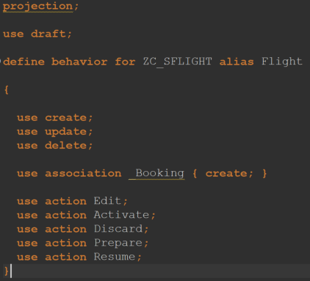
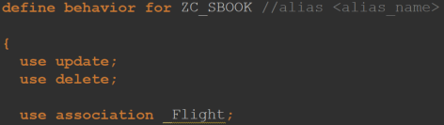
Create Behavior Projection
Create projections of the behaviour definitions
Specify CRUD operations
Specify previously defined actions

Slide 14
ZC_SFLIGHT
projection;
use draft;
define behavior for ZC_SFLIGHT alias Flight
{
use create;
use update;
use delete;
use association _Booking { create; }
use action Edit;
use action Activate;
use action Discard;
use action Prepare;
use action Resume;
}
define behavior for ZC_SBOOK //alias <alias_name>
{
use update;
use delete;
use association _Flight;
use action upgrade_class;
}

Slide 15



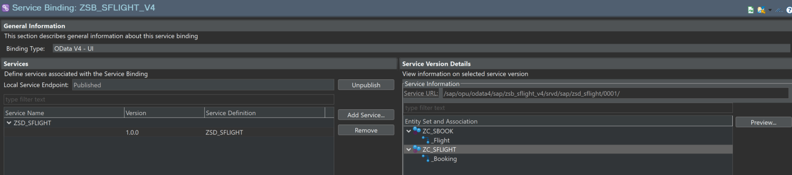
Create Service Defintion
Create Service Bindung
Create service definition and binding (ODATA V4)
Publish service in transaction /n/iwfnd/v4_admin
In Service Binding, click on ZC_SFLIGHT and then on Preview

Slide 16
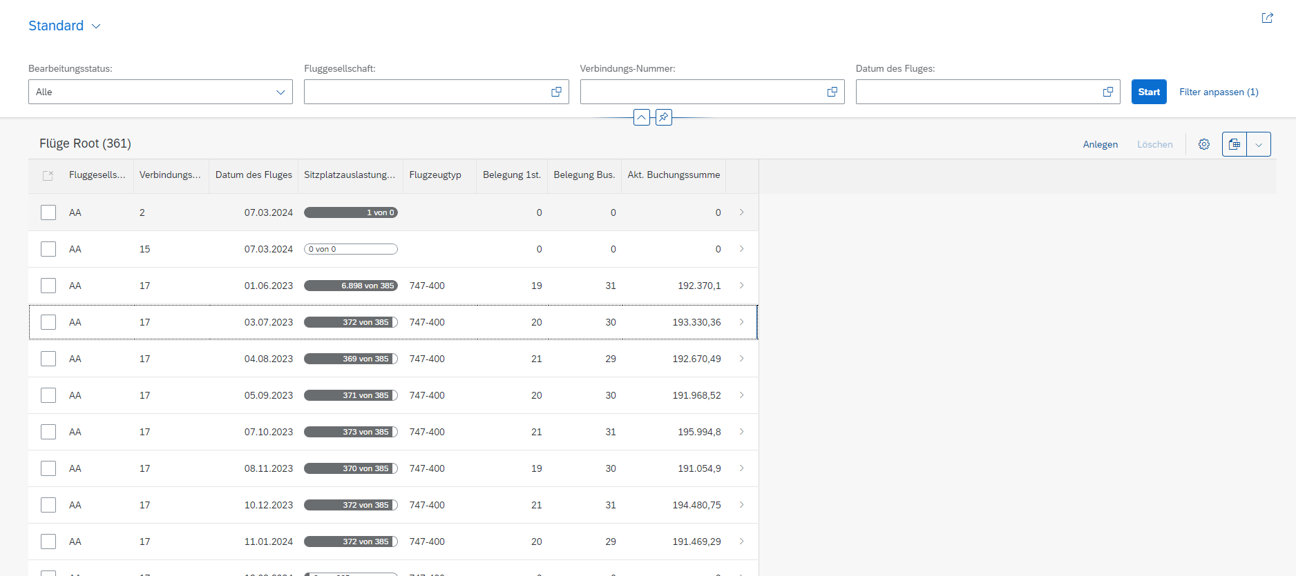

Slide 17
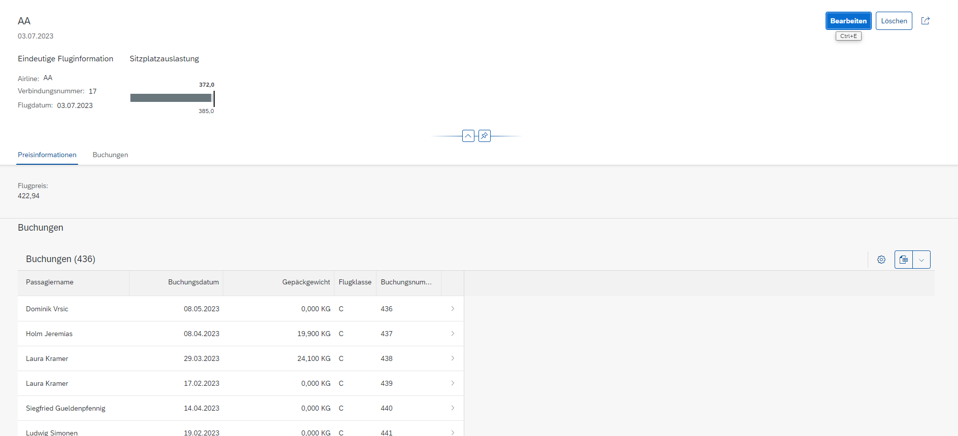

Slide 18
Transactional behaviour

Slide 19

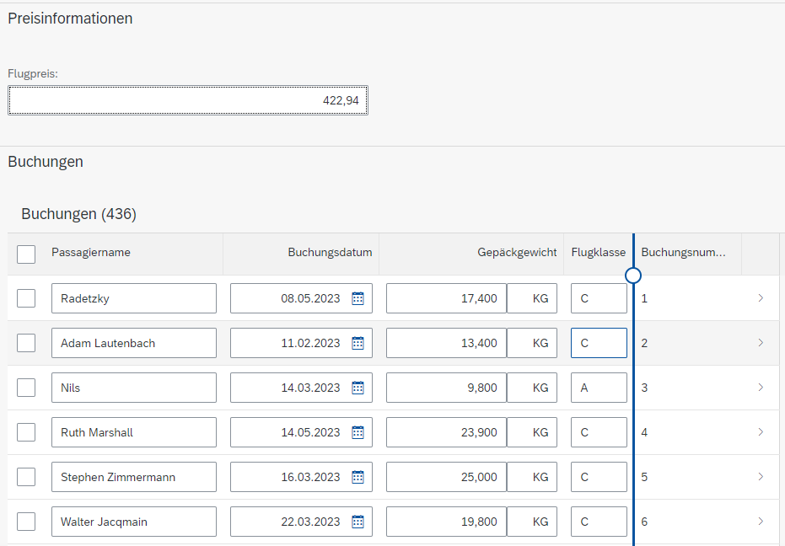
CRUD operations
The standard operations Create, Read, Update, Delete are provided by the BO provider in the RAP Managed Scenario and do not have to be implemented manually
The corresponding buttons appear in the UI as soon as the corresponding definitions have been made in the Behaviour Definitions

Slide 20


Actions
Specify the Action in Behaviour Definition
Specify the action in projection of the behaviour definition
Specify the action as a UI annotation in the appropriate place

Slide 21
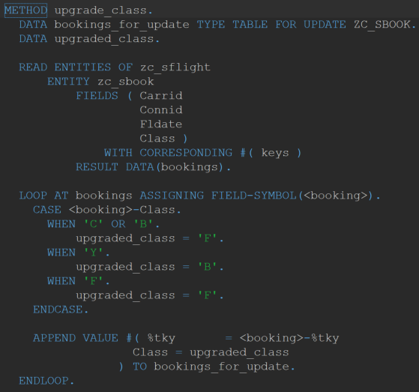
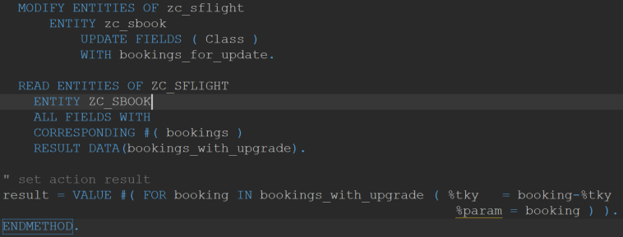
Implement action using EML

Slide 22
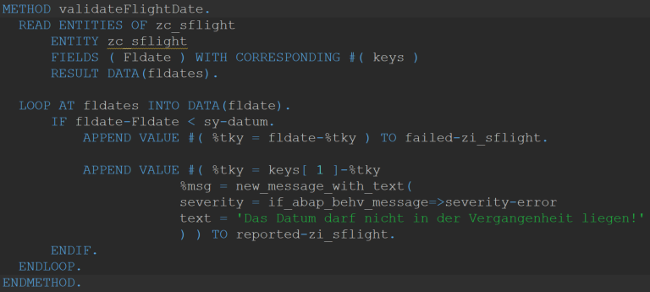
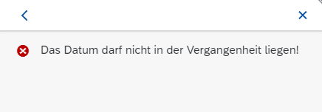
Validations
Specify validation in Behaviour Definition including trigger
Implement validation in behaviour implementation class.
Define error message.

Slide 23
Determinations
Determination similar to Validation in Behaviour Definition.
Task:? Implement determination in behaviour implementation class.
After creating a new booking, the seat occupancy should be updated.

Slide 24
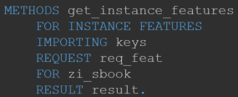
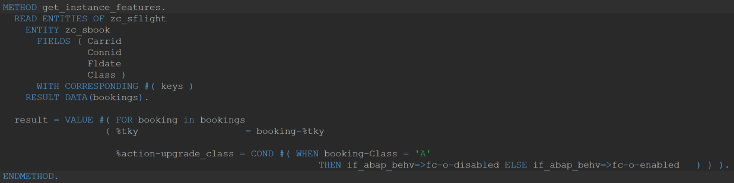
Dynamic Feature Control
Action can be hidden under certain circumstances by specifying the bracket

Slide 25
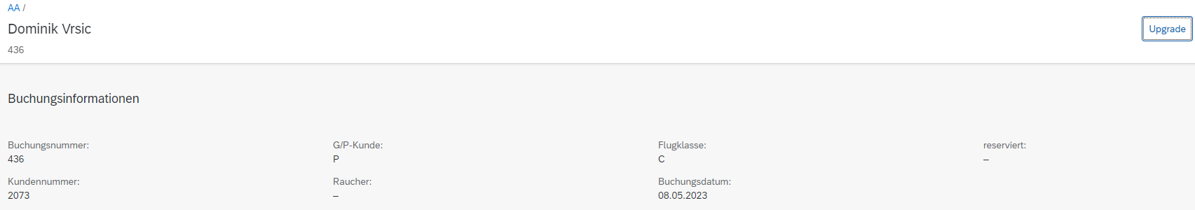
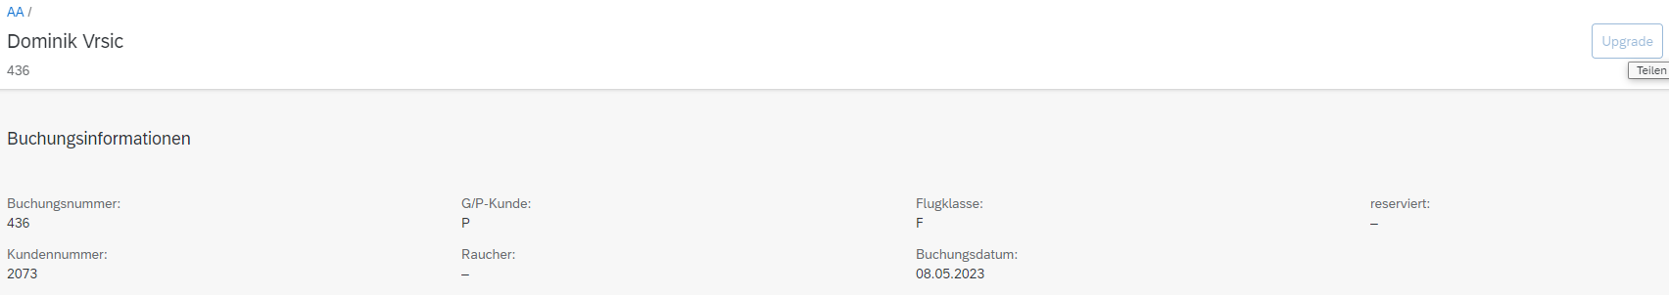
Dynamic Feature Control
If the customer has the highest level, the upgrade button is greyed out.

